Slide 1
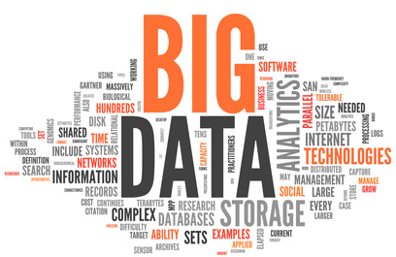
Big Data
NoSQL Database Types: episode I

Slide 2
Content
Setup
Introduction
Key/Value
Column Store

Slide 3
Setup
Go to https://github.com/tomvdbulck/cassandrainitiationsearchworkshop And https://github.com/tomvdbulck/redisinitiationsearchworkshop
Make sure the following items have been installed on your machine:
Java 7 or higher
Git (if you like a pretty interface to deal with git, try SourceTree)
Maven
Install VirtualBox https://www.virtualbox.org/wiki/Downloads
Install Vagrant https://www.vagrantup.com/downloads.html
Clone the repository into your workspace
Open a command prompt, go to the vagrant folder and run vagrant up
This will start up the vagrant box. The first time will take a while (approx. 5 min) as it has to download the OS image, elasticsearch and other dependencies.

Slide 4
Introduction
4 Types of NoSQL
CAP Theorem

Slide 5
Types of NoSQL data stores
Following 4 types exist
Key/Value Store
Column Store
Document Store
Graph Database

Slide 6
Types of NoSQL data stores
Key/Value
key/value
are often “in-memory”
Strength
simple to implement
fast lookup
Weakness
querying
stored data has no schema
Use Case:
Caching
Top 10 list of facebook games

Slide 7
Types of NoSQL data stores
Column Store:
Stores everything in columns
Strength
fast lookup
distributed storage of data
better querying then key/value
Weakness
low-level api
cumbersome to do more complex queryies
Use Case:
Distributed file system
(twitter, netflix)

Slide 8
Types of NoSQL data stores
Document Store:
collections of key/value collections (documents)
Strength
Tolerant of incomplete data
Easier to do more complex queries
Weakness
Query performance
Use Case
standard web applications

Slide 9
Types of NoSQL data stores
Graph Database
store everything in a graph - use of nodes
nodes have relations to adjacent nodes - no index lookup required
Strength
graph algorithms
visualize relations
Weakness
has to traverse entire graph to get answer
not easy to cluster
Use Case:
Social Networking
Recommendations

Slide 10
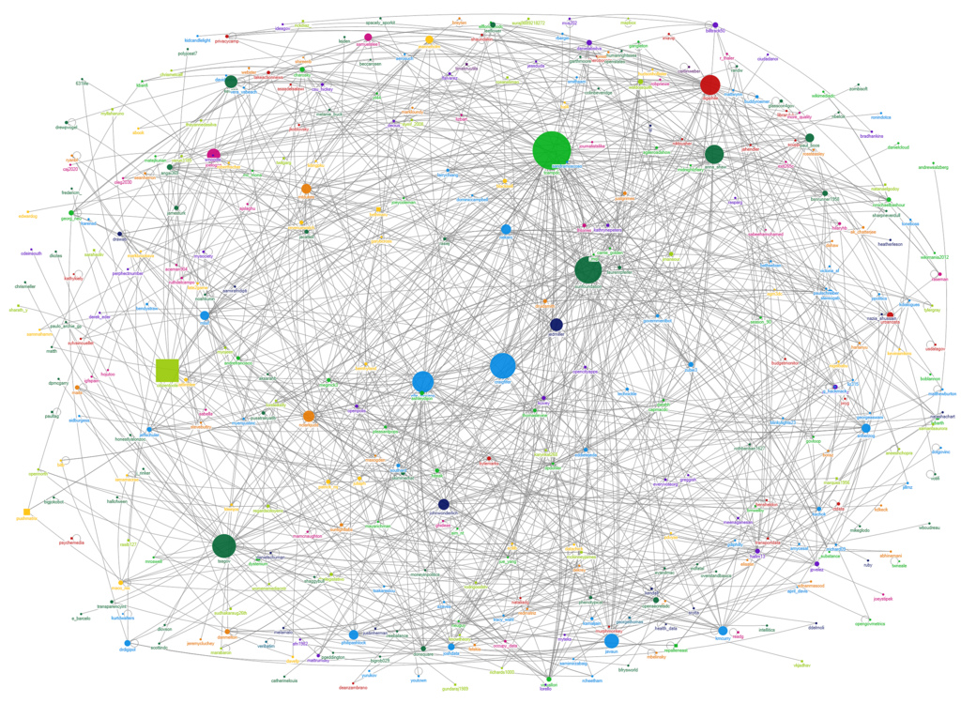
Types of NoSQL data stores

Slide 11
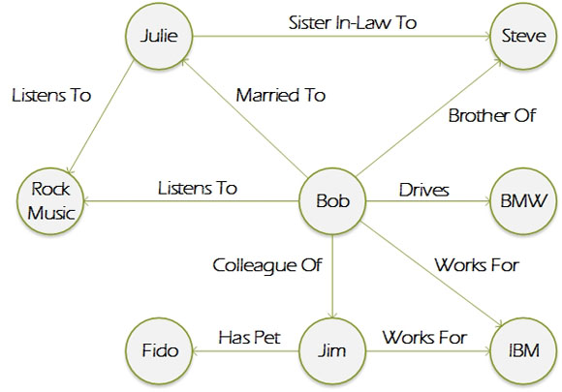
Types of NoSQL data stores
Graph Database:

Slide 12
Types of NoSQL data stores
Graph Database: playing around
Visualize your own linkedin network:
http://neo4j.com/blog/exploring-linkedin-in-neo4j/

Slide 13
Types of NoSQL data stores
Which to use?
Often you will be using more then one, based on which one is the best fit for specific requirements
You could also use 1 for development - schemaless, pretty feature complete (document store) and when feature-complete choose more appropriate databases.
=> a modular architecture will be important when you develop like this

Slide 14
CAP Theorem
Impossible for a distributed file system to simultaneously provide the following guarantees:
Consistency: all nodes see the same data at the same time
Availability: guarantee that every request receives a response about whether it succeeded or failed
Partition Tolerance: the system continues to operate despite arbitrary message loss or failure of part of the system

Slide 15

CAP Theorem
Consistency:
When I ask the same question to any part of the system I should get the same answer.

Slide 16
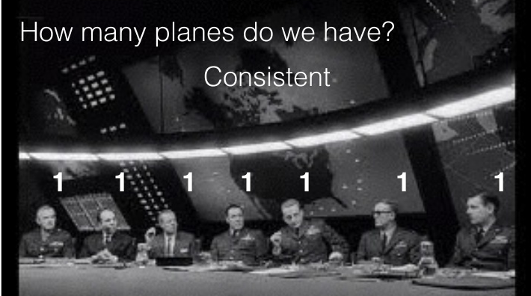
CAP Theorem
Consistency:
When I ask the same question to any part of the system I should get the same answer.

Slide 17
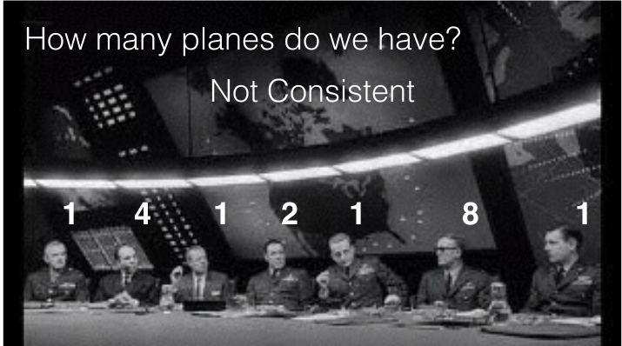
CAP Theorem
Consistency:
When I ask the same question to any part of the system I should get the same answer.

Slide 18

CAP Theorem
Availability:
When I ask a question I will get an answer.

Slide 19

CAP Theorem
Availability:
When I ask a question I will get an answer.

Slide 20
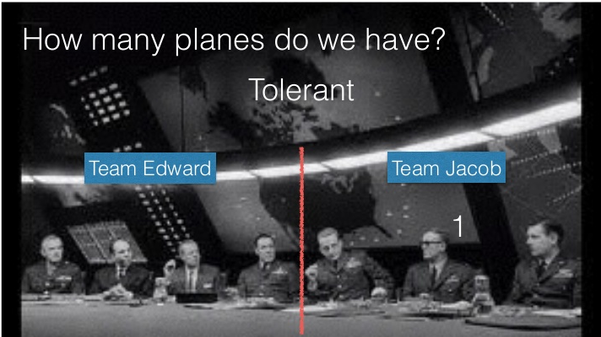
CAP Theorem
Partition Tolerance:
I can ask questions even if the system is having intra-system communication problems

Slide 21
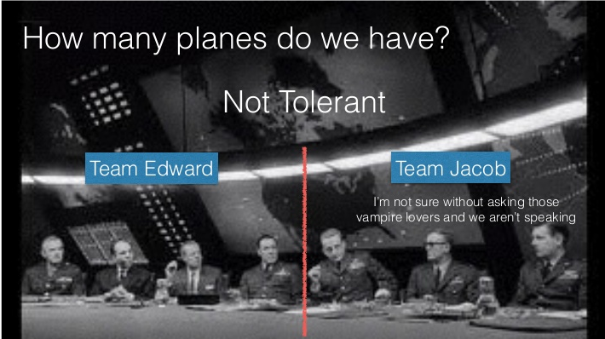
CAP Theorem
Partition Tolerance:
I can ask questions even if the system is having intra-system communication problems

Slide 22
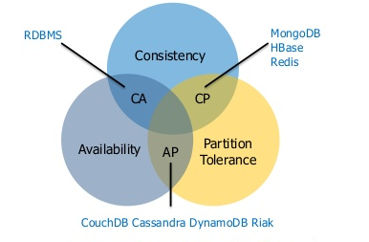
CAP Theorem

Slide 23
CAP Theorem
Consistent Available (CA):
have trouble with partitions and deal with it via replications
Examples: RDBMs
Consistent, Partition-Tolerant (CP):
have trouble with availability while keeping data consistent across partitioned nodes
Examples: MongoDB, HBase,BigTable, HyperTable, Redis
Available, Partition-Tolerant (AP)
achieve “eventual consistency” through replication and verification
Examples: CouchDB, Cassandra, Voldemort, Riak

Slide 24
Content
Key/Value
Column Store

Slide 25
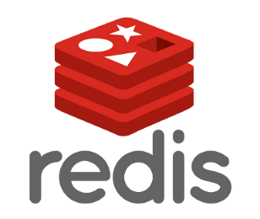
Key/Value

Slide 26

Column Store

Slide 27

Questions or Suggestions?
Notes:
Elasticsearch meetup group - http://www.meetup.com/ElasticSearch-User-Group-Belux-Belgium-Luxembourg/

